Slide 1
Peer to Peer Workshop
Understanding Peer Abandonment in BitTorrent networks

Slide 2
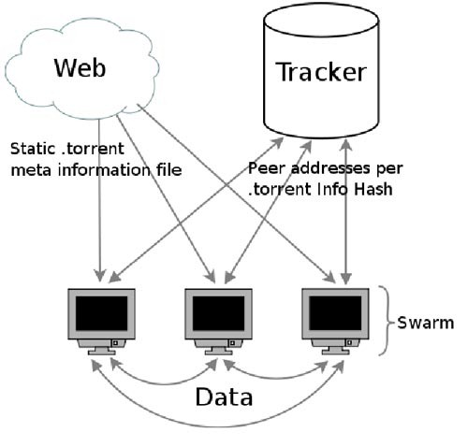

Introduction to BitTorrent

Slide 3
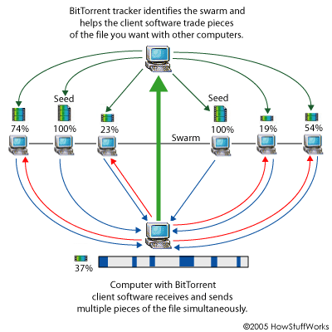
Introduction to BitTorrent

Slide 4
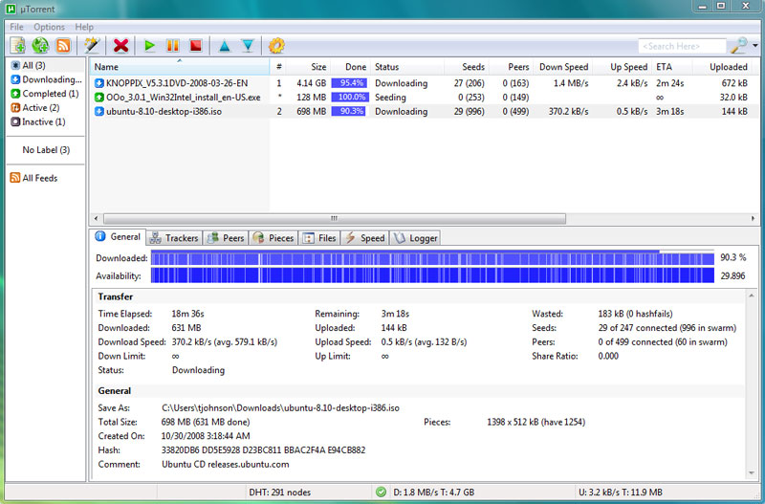
BitTorrent – Overview

Slide 5
Understanding Peer Abandonment
Abandonment – departure of a peer before completing the file download
Swarm size & Torrent Size
Peer’s DL & Completion rate

Slide 6
Challenges
Collect ‘enough’ information
How to collect enough information about abandonments in the swarm for statistical purposes?
Identify peer abandonment
How can we be sure that the peer has actually left?
Collect abandonment parameters
How can we know what’s the peer’s DL and completion rate at abandonment?

Slide 7
The BitTorrent Protocol
Peer to Peer
Peer to Tracker
Bitfield
Have
Keep Alive
The pieces I hold
I have a certain piece
Handshake
Identify each other
I’m still here
Info Hash
An ID of the torrent
The client stopped / completed
Stopped / Completed
Tracker to Peer
Peers
A subset of peers from the swarm

Slide 8
What to do?
 | Client | Tracker
Peer abandonment | An educated guess | Using stopped event
Abandonment parameters | Conclude from events | Not in the protocol
Enough information | Connect to many peers | Who’ll use our tracker?

Slide 9
TIMCrawler Client Torrent Impatience Monitor
Identify peer abandonment
Continuously try to reconnect to known non-seeders peers
Collect abandonment parameters
Determine peer’s DL rate using the ‘Have’ frequency
Collect ‘enough’ information
Each test is a 24h run in a single swarm
Never become a seeder (to assure ‘Have’ msgs are sent)
Connect to many peers
‘Play by the rules’
Collect all data to a DB and analyze later

Slide 10
Results – Swarm size

Slide 11
Results – File size

Slide 12
Results – Completion rate

Slide 13
Results – Download rate

Slide 14


Conclusions
Swarm size
File size
Completion rate
Download rate
Higher abandonment rate on small swarms
Does not seem to affect abandonment
Most abandoners departure at the very beginning
Significant impact of DL rate on abandonment

